Slide 1
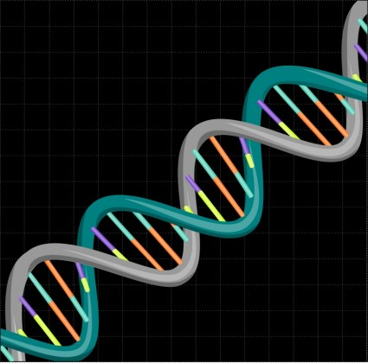
Are You an Accident of Nature?
Part 4
No information by chance
DNA
Drawing by
Gustavo Rezende

Slide 2
Fact of Information science
Information is not
created by chance.
(In meaningful amounts,
like a sentence or a protein.)
Notes:
Hybrids – combining information from two different creatures is not new information
Polyploid (Widipedia)
cells and organisms are those containing more than two paired (homologous) sets of chromosomes. Most species whose cells have nuclei (Eukaryotes) are diploid, meaning they have two sets of chromosomes—one set inherited from each parent.
Mike’s version: Gene duplication either within, or across 2 species, so that the resultant creature has extra genes.

Slide 3
Know for Certain
The DNA code for proteins
Probability of the correct code
for a protein
Impossible Chance + Natural Selection could create a single typical protein
Notes:
We know for certain: Than Chance + Natural Selection could not create a single typical human protein. We will explain that in one of the following videos.

Slide 4
Information is not created by
Chance
+
Natural Selection.
Notes:
Info is cannot be created by Chance + Natural Selection. But the Theory of Evolution assumes this is true. This by itself falsifies the Theory of Evolution. You don’t have to go any further and study fossils and such to know that evolution is not true. Information science shows that the underlying idea of evolution – information by chance, is a false one.

Slide 5
Information of Life
Genetics
Drawing by
Gustavo Rezende
Notes:
Thanks to modern genetics, we now have one way of roughly measuring the information in DNA. More info in your DNA than the 32 volume set of the of the Encyclopedia Brittanica. Wikipedia says Wikipedia has about 40 million words. Compare this to the 3 billion nucleotides in DNA. “2010 version of the 15th edition, which spans 32 volumes^{[1]} and 32,640 pages, was the last printed edition;” Wikipedia

Slide 6
Mutations + Natural Selection
Can produce small changes in information
Cannot produce significant increases in complexity

Slide 7
Know of 1000’s of mutations. Many of these create diseases:
  Sickle Cell Anemia
  Color blindness
  Cystic Fibrosis
But no known mutations that increase information.
Notes:
All of the listed diseases are caused by a mutation to a single gene and are inherited.
Also: Tay-Sachs disease, phenylketonuria
Lee Spetner – no know mutations that increase info. Only those that damage it.
----------- Below from Creation.com, Jonathan Sarfati ------------------- Refuting Evolution 2
http://creation.com/refuting-evolution-2-chapter-5-argument-some-mutations-are-beneficial
Duplication of a single chromosome is normally harmful, as in Down’s syndrome. Insertions are a very efficient way of completely destroying the functionality of existing genes. Biophysicist Dr Lee Spetner in his book Not By Chance analyzes examples of mutational changes that evolutionists have claimed to have been increases in information, and shows that they are actually examples of loss of specificity, which means they involved loss of information (which is to be expected from information theory).
The evolutionist’s ‘gene duplication idea’ is that an existing gene may be doubled, and one copy does its normal work while the other copy is redundant and non-expressed. Therefore, it is free to mutate free of selection pressure (to get rid of it). However, such ‘neutral’ mutations are powerless to produce new genuine information. Dawkins and others point out that natural selection is the only possible naturalistic explanation for the immense design in nature (not a good one, as Spetner and others have shown). Dawkins and others propose that random changes produce a new function, then this redundant gene becomes expressed somehow and is fine-tuned under the natural selective process.
This ‘idea’ is just a lot of hand-waving. It relies on a chance copying event, genes somehow being switched off, randomly mutating to something approximating a new function, then being switched on again so natural selection can tune it.
Furthermore, mutations do not occur in just the duplicated gene; they occur throughout the genome. Consequently, all the deleterious mutations in the rest of the genome have to be eliminated by the death of the unfit. Selective mutations in the target duplicate gene are extremely rare—it might represent only 1 part in 30,000 of the genome of an animal. The larger the genome, the bigger the problem, because the larger the genome, the lower the mutation rate that the creature can sustain without error catastrophe; as a result, it takes even longer for any mutation to occur, let alone a desirable one, in the duplicated gene. There just has not been enough time for such a naturalistic process to account for the amount of genetic information that we see in living things.
Dawkins and others have recognized that the ‘information space’ possible within just one gene is so huge that random changes without some guiding force could never come up with a new function. There could never be enough ‘experiments’ (mutating generations of organisms) to find anything useful by such a process. Note that an average gene of 1,000 base pairs represents 4¹⁰⁰⁰ possibilities—that is 10⁶⁰² (compare this with the number of atoms in the universe estimated at ‘only’ 10⁸⁰). If every atom in the universe represented an ‘experiment’ every millisecond for the supposed 15 billion years of the universe, this could only try a maximum 10¹⁰⁰ of the possibilities for the gene. So such a ‘neutral’ process cannot possibly find any sequence with specificity (usefulness), even allowing for the fact that more than just one sequence may be functional to some extent.

Slide 8
Chance of “spelling” a typical protein correctly by accident?

Slide 9
Odds Getting Double Sixes
1
2
3
4
5
6
1
2
3
4
5
6

Slide 10
Odds Getting Double Sixes
1
2
3
4
5
6
1
2
3
4
5
6

Slide 11
Odds Getting Double Sixes
1
2
3
4
5
6
1
2
3
4
5
6
6
x
6
= 36

Slide 12
N
6 x 6
x 6
= 216
1
2
3
4
5
6
1
2
3
4
5
6
1
2
3
4
5
6

Slide 13
N
6 x 6 x 6
= 216
1
2
3
4
5
6
1
2
3
4
5
6
1
2
3
4
5
6

Slide 14
Joint Probability
_ _ _ _ _
1 1 1 1
x x =
6 6 6 216

Slide 15
N
6 x 6
x 6
= 216
Number of Die | Chance of All Sixes
1 | 6
2 | 36
3 | 216
4 | 1,296

Slide 16
Exponential

Slide 17
Order Matters
In information, Order matters
$0,019 or $9,001 ?

Slide 18
Order Matters
mntfnrioaio?
or
information?

Slide 19
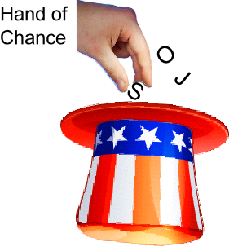
Spell “i-n-f-o-r-m-a-t-i-o-n” by chance?

Slide 20
Chance of Spelling Information
i
n
f
o
r
m
a
t
i
o
n
1
26
1
26
1
26
1
26
1
26
1
26
1
26
1
26
1
26
1
26
1
26
__
__
__
__
__
__
__
__
__
__
__

Slide 21
Odds of spelling “information” by chance:
11
26
= 3,670,000,000,000,000
3,670 trillion

Slide 22
Probabilities
3,670,000,000,000,000 Information
292,000,000 Powerball
6,100,000 Death by
Bee Sting
Notes:
You are more than 10 million times more likely to win Powerball than spell the single word “information” by chance.

Slide 23
Information in a Protein
Proteins – Building Blocks of Life
Amino acids – Building Blocks of Proteins
Each protein is made up of a chain of Amino Acids

Slide 24
20 Standard Amino Acids
Alanine
Arginine
Asparagine
Aspartic acid
Cysteine
Glutamic acid
Glutamine
Glycine
Histidine
Isoleucine
Leucine
Lysine
Methionine
Phenylalanine
Proline
Serine
Threonine
Tryptophan
Tyrosine
Valine

Slide 25
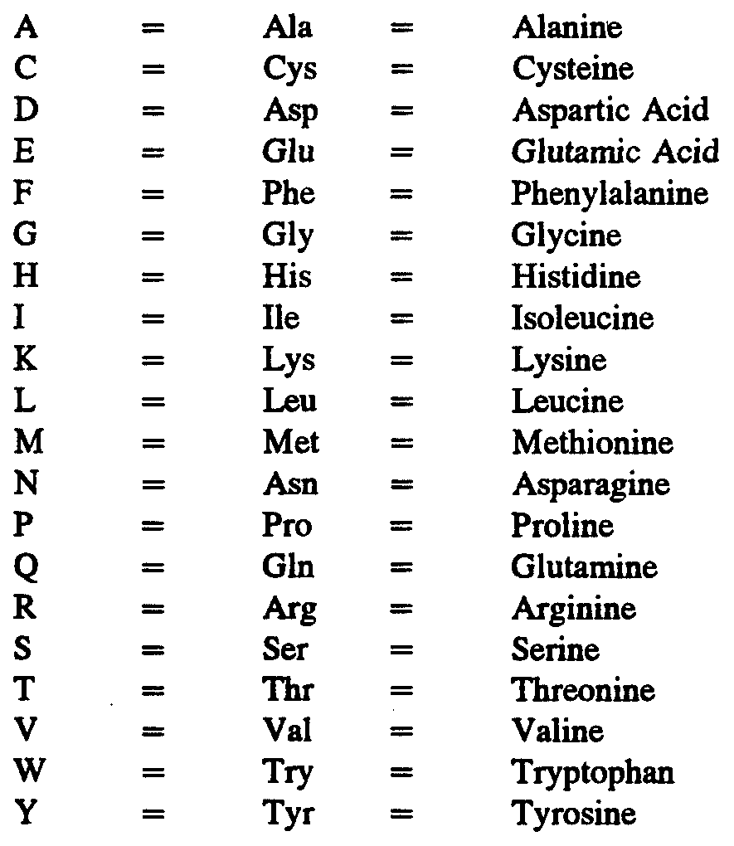

Slide 26
DNA
Base
Drawing by
Gustavo Rezende
Base
Notes:
DNA is made up of a long chain of bases. To be more accurate, DNA is made up of a long chain of nucleotides. A nucleotide consists of a base plus a sugar plus 1 to 3 phosphate groups. (Mike’s words)
---------- From: knowgenetics.org/nucleotides-and-bases/
Nucleotides and Bases. ... A chemical bond between the phosphate group of one nucleotide and the sugar of a neighboring nucleotide holds the backbone together. Chemical bonds (hydrogen bonds)between the bases that are across from one another hold the two strands of the double helix together.
---------- From Yahoo Answers -------------
A nitrogenous base is a part of a nucleotide. In DNA, the primary nitrogenous bases are adenine, guanine, cytosine, and thymine. In RNA, the nucleotides are the same as those of DNA, except that thymine is replaced by uracil. A nucleotide is a monomer of nucleic acids (DNA and RNA), which is composed of a nitrogenous base, a sugar (deoxyribose in DNA, ribose in RNA), and a phosphate group. When one talks about protein synthesis, he/she would usually say the word "nucleotide," when in fact, he/she is talking specifically about the nitrogenous base. The reason is so that we can differentiate between one nucleotide and the other. We usually disregard the sugar and the phosphate group because every nucleotide has them. This is confusing, but it's a common error. When we are talking about a huge nucleic acid, we usually use the word nucleotide. However, when we are talking specifically about a nucleotide, we use the word nitrogenous base to highlight all of the parts of a nucleotide.

Slide 27
2 Step Code for Proteins
Group of bases specifies an amino acid
Group of amino acids specifies a protein

Slide 28
Only 4 Bases
A = Adenine
T = Thymine
C = Cytosine
G = Guanine
ATTGCTATGAATTCGATCGATACGACT

Slide 29
DNA Base Pairs
A – T
C – G

Slide 30
DNA
Drawing by
Gustavo Rezende
C
A
C
A
A
C
G
T
G
G
T
G
T
T
C
A

Slide 31
Amino Acid Code
Triplets (Codons)
CCA = Proline
ACC = Threonine

Slide 32
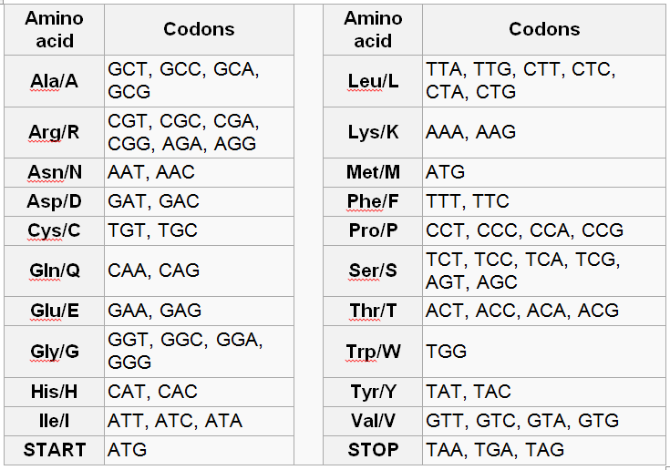
Notes:
Here is a another table showing the 20 amino acids. For Proline, there are 4 different triplets of bases that all mean “Proline”. In addition, there are base codes that tell where to Start and Stop a protein. ATG, the Start code, does double duty. It is also is used for Methionine.

Slide 33
1
20
__
1
20
__
C
A
1
20
1
20
__
C
__
A
A
C
G
T
G
T
T
C
Drawing by
Gustavo Rezende

Slide 34
Chance of Spelling a Protein?
A = Amino Acid
A
A
A
A
A
A
A
A
A
A
A
1
20
1
20
1
20
1
20
1
20
1
20
1
20
1
20
1
20
1
20
1
20
__
__
__
__
__
__
__
__
__
__
__

Slide 35
Chance of Spelling Information
i
n
f
o
r
m
a
t
i
o
n
1
26
1
26
1
26
1
26
1
26
1
26
1
26
1
26
1
26
1
26
1
26
__
__
__
__
__
__
__
__
__
__
__

Slide 36
Chance of Spelling a Protein?
A = Amino Acid
A
A
A
A
A
A
A
A
A
A
A
1
20
1
20
1
20
1
20
1
20
1
20
1
20
1
20
1
20
1
20
1
20
__
__
__
__
__
__
__
__
__
__
__

Slide 37
Protein
Medium size protein has 300 amino acids
At least 80% must be correct,
which is 240 amino acids ^{1.}
1. Journal of Molecular Biology J. Mol. Biol. (2000) 301, 585±595,
Extreme Functional Sensitivity to
Conservative Amino Acid
Changes on Enzyme Exteriors
by Douglas D. Axe
Notes:
Median protein length is about 267 AA for bacteria and 375 AA for humans.
At lease 80% amino acids must be correct based on a peer reviewed paper by Douglas Axe published in a secular journal:
Reference
Journal of Molecular Biology J. Mol. Biol. (2000) 301, 585±595,
Extreme Functional Sensitivity to Conservative Amino Acid Changes on Enzyme Exteriors
by Douglas D. Axe
“Rather than saying the bacterium gained resistance to the antibiotic, it is more correct to say that is lost sensitivity to it. ... All point mutations that have been studied on the molecular level turn out to reduce the genetic information and not increase it.” Lee Spetner, Not by Chance, Shattering the Modern Theory of Evolution^{[7]}

Slide 38
Protein by Chance:
240
312
20
= 10
312 zeroes !
Notes:
If we took every atom in the visible universe, about 10^80, and made another universe out of them (10^160), there would be a be a better chance of picking a particular electron by chance at random out of them than spelling a typical functioning protein by chance.

Slide 39
Probabilities
10²² Sand Grains on All Shores
10²⁶ Water Drops in All Oceans
10⁸⁰ Atoms in Visible Universe
10³¹² Spelling a Protein by Chance

Slide 40
Proteins
“With a few exceptions, the machinery of the cell consists of assemblies of proteins or, less frequently, individual proteins.”
The Edge of Evolution
Michael Behe, Appendix A, pg 246
Notes:
Going to talk about proteins, because proteins are the main ingredients of life. We know exactly how DNA codes for proteins. Note assemblies. Most things are done by combinations of proteins. But if the function requires multiple proteins, and each individual protein’s amino acid sequence is highly improbable, how can you possibly get two or three proteins that are highly specific in how they match the other?

Slide 41
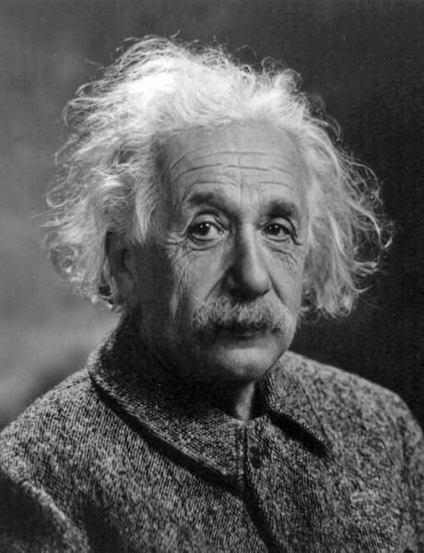
Thought Experiments
Thought Experiment
Best Case Analysis
Notes:
When Einstein did not have the equipment to test a theory, he devised thought experiments to test his ideas.

Slide 42
Creating Life on Earth by Chance
Best Case
Assume every place on earth is perfect for life
Assume earth is 100 billion years old
(No one thinks it is near this old.)
Assume the greatest possible number of atoms (Earth’s mass is all hydrogen atoms)
Assume every atom is a computer programmed to guess combinations of DNA at a rate of a billion times a second

Slide 43
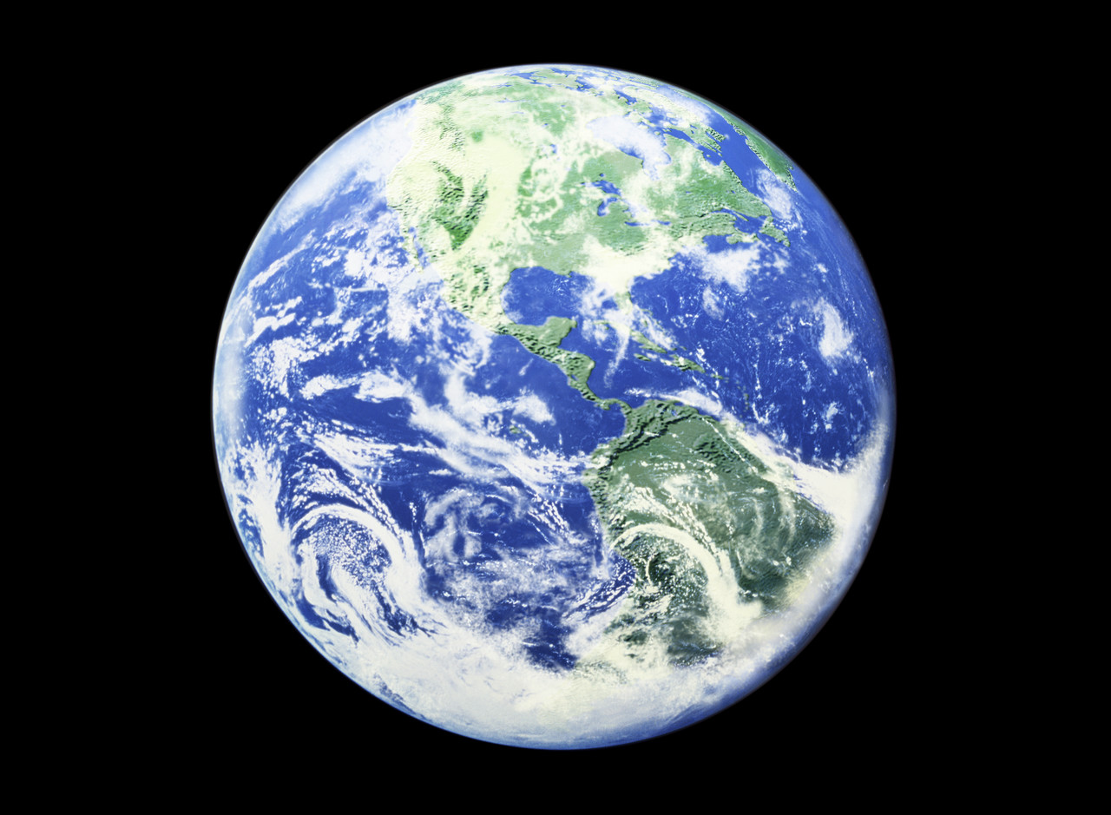

All of Earth Perfect for Life

Slide 44


Assume Huge Age of Earth
All 100
Estimates Billion

Slide 45

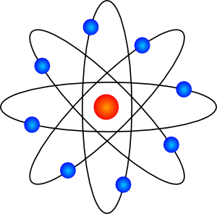
Every Atom a Computer
DNA

Slide 46
A single protein?
How many combinations if every atom on earth was calculating at 1 billion combinations per second for 100 billion years?
87
Provided: 10
312
Required: 10
Notes:
Provided: 2.2 x 10^87
Required: 1.0 x 10^312

Slide 47
Life on Earth by Chance?
Impossible!

Slide 48
Once you have simple life,
it is also impossible to create the information for new kinds of life by mutations plus natural selection. (Later video)

Slide 49
Since the creation of the world
God’s invisible attributes are clearly seen,
being understood by the things that are made,
even His eternal power . . .
Bible - Romans 1:20

Slide 50
All things were made through Him (Jesus).
Without Him nothing was made
that was made.
Bible – John 1:3

Slide 51
Give your own presentations.
Free downloads of Powerpoints used in these videos at:
Educate7.com
How7.org
Are You an Accident of Nature?

Slide 52
Next:
Are You an Accident of Nature?
Part 5
Evolutionist Richard Dawkins
Maybe aliens created life.

